Slide 1

UNIT 9A
DO YOU WANT A CAR?
(QUESTION MODEL 1.1)

Slide 2



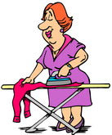




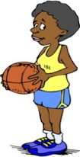

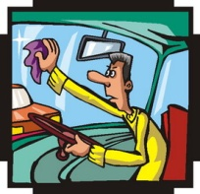










VOCABULARY – TRANSITIVE VERBS
TO WANT | TO HAVE | TO IRON | TO PEEL
TO NEED | TO WASH | TO OPEN | TO KEEP
TO LIKE | TO CLEAN | TO CLOSE | TO MEND
TO HATE | TO CARRY | TO COOK | TO BRUSH
TO LOVE | TO SWEEP | TO FEED | TO COMB

Slide 3
VOCABULARY - PICTURES

Slide 4
VOCABULARY - LISTENING

Slide 5
MODEL FORMING
QUESTION MODEL 1.1
DO YOU WANT A CAR?
YES, I WANT A CAR.
NO, I DON’T WANT A CAR.

Slide 6
QUICK REACTION PRACTICE
Want | a car | a house | money
Need | a pencil | an eraser | a ruler
Like | music | sports | movies
Hate | fish | beef | pork
Love | flowers | animals | beer
Have | a drum | a piano | a guitar
Wash | clothes | ties | shoes
Clean | the windows | the kitchen | the sofa
Carry | a book | a notebook | a knife
Sweep | the floor | the wall | the ceiling
Iron | jeans | T-shirts | gloves
Open | the gate | the door | the windows
Close | the shop | the curtains | the door
Cook | breakfast | lunch | dinner
Feed | the cat | the dog | the baby
Peel | potatoes | tomatoes | bananas
Keep | the bag | the money | the key
Mend | T-shirts | skirts | trousers
Brush | your teeth | your hair
Comb | your hair

Slide 7
HOMEWORK
Write 20 questions and answers using Question Model 1.1

